Slide 1
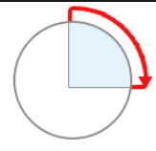
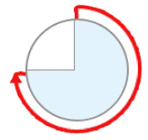
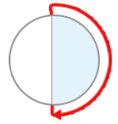

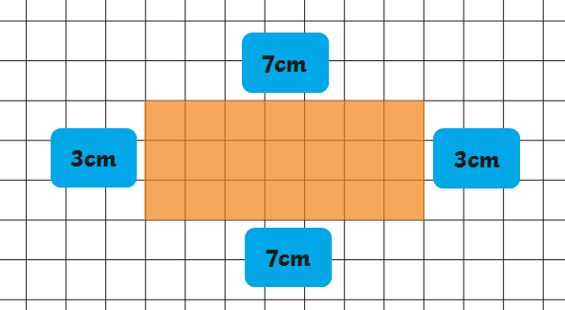

Roman Numerals
1 | I
2 | II
3 | III
4 | IV
5 | V
6 | VI
7 | VII
8 | VIII
9 | IX
10 | X
11 | XI
12 | XII
Days in a Month | Months of the Year
January | 31 days
February | 28 days
March | 31 days
April | 30 days
May | 31 days
June | 30 days
July | 31 days
August | 31 days
September | 30 days
October | 31 days
November | 30 days
December | 31 days
Unit Fraction | Non-unit Fraction
Any fraction with 1 as its numerator (top number) | Any fraction with a numerator (top number) greater than 1
Horizontal | Vertical
Perpendicular | Parallel
At an angle of 90 degrees | Always having the same distance between two lines
Angles as Turns
One right angle is one quarter turn | Three right angles is a three-quarter turn
Two right angles are one half turn | Four right angles is a full turn
AM | = | Before midday
PM | = | After midday
Midday | = | 12:00
60 seconds | = | 1 minute
60 minutes | = | 1 hour
24 hours | = | 1 day
10mm 100cm | = = | 1 cm 1m
1,000g | = | 1kg
1,000ml | = | 1l
Perimeter
Perimeter is the total length of the outside of a shape.
12am | 00:00
1am | 01:00
2am | 02:00
3am | 03:00
4am | 04:00
5am | 05:00
6am | 06:00
7am | 07:00
8am | 08:00
9am | 09:00
10am | 10:00
11am | 11:00
12pm | 12:00
1pm | 13:00
2pm | 14:00
3pm | 15:00
4pm | 16:00
5pm | 17:00
6pm | 18:00
7pm | 19:00
8pm | 20:00
9pm | 21:00
10pm | 22:00
11pm | 23:00

